Slide 1
Supernova bounds on dark photons
Yongchao Zhang
In collaboration with Rabindra Mohapatra, Shmuel Nussinov,
Vigdor L. Teplitz & Demos Kazanas
NPB890 (2014) 17 [arXiv:1410.0221]
ULB, Oct. 9, 2015

Slide 2
Publication list
Ligong Bian, Da Liu, Jing Shu & YCZ, Interference Effect on Resonance Searches and the Diboson Excess, arXiv:1509.02787
Ligong Bian, Jing Shu & YCZ, Prospects for Triple Gauge Coupling Measurements at Future Lepton Colliders and the 14 TeV LHC, JHEP09 (2015) 206 [arXiv:1507.02238]
D. Kazanas, R. N. Mohapatra, S. Nussinov, V. L. Teplitz & YCZ, Supernova Bounds on the Dark Photon Using its Electromagnetic Decay, NPB890 (2015) 17 [arXiv:1410.0221].
R. N. Mohapatra & YCZ, TeV Scale Universal Seesaw, Vacuum Stability and Heavy Higgs, JHEP06 (2014) 072 [arXiv:1401.6701].
R. N. Mohapatra & YCZ, LHC Accessible Second Higgs Boson in the Left-Right Model, PRD89 (2014) 055001 [arXiv:1401.0018].
YCZ, Xiangdong Ji & R. N. Mohapatra, A Naturally Light Sterile neutrino in an Asymmetric Dark Matter Model, JHEP10 (2013) 104 [arXiv:1307.6178].
YCZ, Majorana neutrino mass matrices with three texture zeros and the sterile neutrino, PRD87 (2013) 053020 [arXiv:1301.7302].
Wei Chao, Jian-Hui Zhang & YCZ, Vacuum Stability and Higgs Diphoton Decay Rate in the Zee-Babu Model, JHEP06 (2013) 039 [arXiv:1212.6272].
More earlier works…

Slide 3
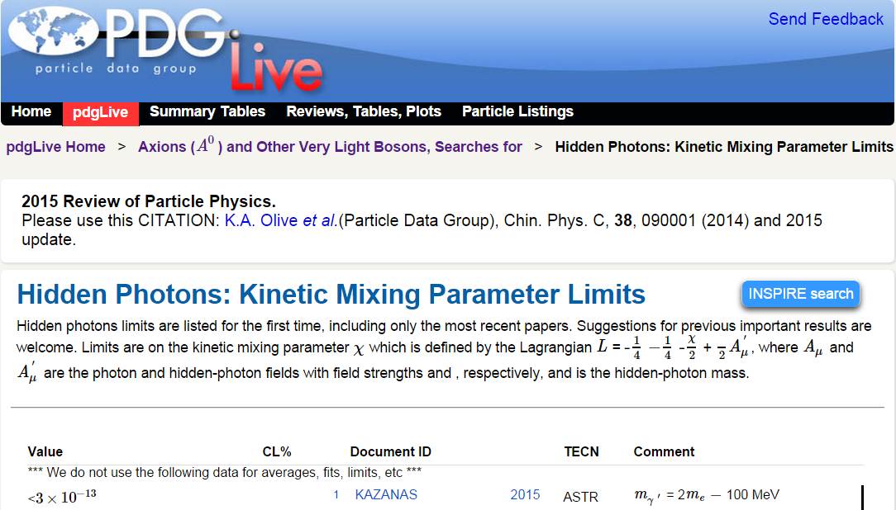

Slide 4
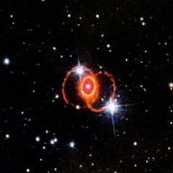
Contents (brain map)
producing in the core
Dark photon
SN(1987A)
observations
If M > 2m_{e}
If M < 2m_{e}
Constraints
Decaying outside the core Constrained by the luminosity (1201.2683)
Decaying at the cosmological scale Constrained by luminosity & gamma-rays
Decaying in the mantle Constrained by the binding energy
Decaying at the surface Constrained by the gamma-rays

Slide 5
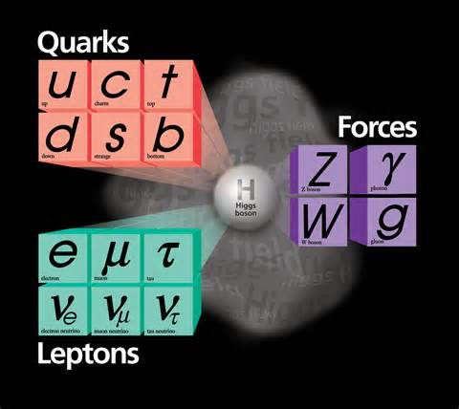
Standard model
SM is very successful
far from to be complete
neutrino masses
dark matter
baryogenesis
hierarchy?
grand unification?
……
Notes:
What can the upcoming expts tell us: LHC II, DM expts, “Low” energy expts …?

Slide 6
Beyond SM?
New spacetime symmetry supersymmetry …
New matter content RH neutrinos, heavy (or light) (pseudo-)scalars, vector-like fermions …
Extra dimension(s) UED, string theory, M-theory, F-theory …
New (long/short range) forces
Abelian or non-Abelian gauge interactions from UV completions or simplified scenarios

Slide 7
Dark photon (DP)
New gauge bosons (DP)
BROKEN Extra U(1) gauge symmetry
Extra U(1) gauge symmetry:
Connecting the visible world to the dark matter, dark sector, dark world…
Solution to the muon g-2 discrepancy 0811.1030
……
New massive gauge boson:
“hidden/secluded”, “para-”, “heavy/mssive” photon (U boson)
Dark Z boson

Slide 8
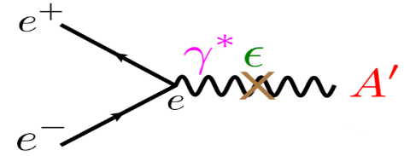
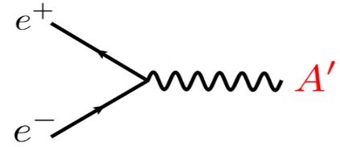
Coupling to the visibles: Kinetic mixing
Kinetic mixing and couplings
More general mixing with SM photon and Z boson “effective” DP: in the limit of ε_{Z} --> 0 mixing to Z boson: leading to low energy parity violating effects
The kinetic mixing parameter can be generated perturbatively or non-perturbatively in a large number of beyond SM scenarios. no actual theoretical constraints on its value
1203.2947
1402.3620
1311.0029

Slide 9
Current constraints
1002.0329; 1205.2671;
1303.1821; 1311.0029
Electron beam dump experiments E137, E141, E774, Orsay …
Electron fixed-target experiments APEX@JLab, A1@MAMI Proposed: APEX, HPS, DarkLight, A1, MESA …
Electron-Positron Colliders KLOE@DAΦNE, BaBar, Proposed: KLOE, BaBar, Belle …
Proton Beam Dump Experiments (meson decaying into photo-DP) LSND, CHARM, ν-CalI, NOMAD, PS191 Proposed: SeaQuest (E906) …
Kaon decay, hadron colliders (WASA), LHCb, ATLAS, CMS, NA48/2, astrophysical, cosmological, DM searches…
bremsstrahlung
bremsstrahlung
annihilation
decay
Notes:
LHCb: 1509.06765
DM accumulating and annihilating in the Earth core: 1509.07525
E906: 1509.00050

Slide 10
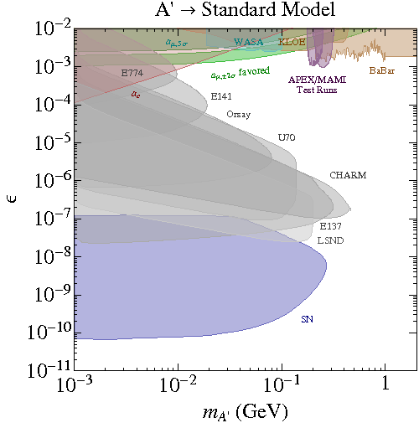
Current constraints
1002.0329; 1205.2671;
1303.1821; 1311.0029
SN1987A luminosity constraint 1201.2683

Slide 11
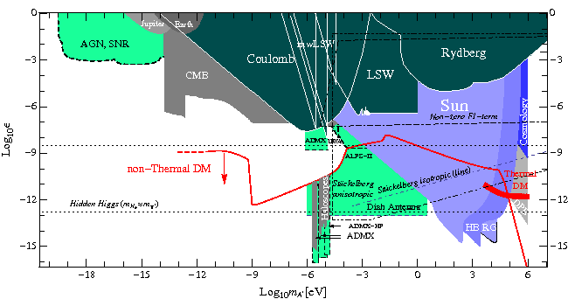
Constraints for mass <2m_{e}
1002.0329; 1205.2671;
1303.1821; 1311.0029
Notes:
Regions bounded by dotted lines show
predictions from string theory corresponding to different possibilities for the nature of the A0 mass:
Hidden-Higgs, a Fayet-Iliopoulos term, or the St¨uckelberg mechanism. Predictions are uncertain
by O(1)-factors

Slide 12
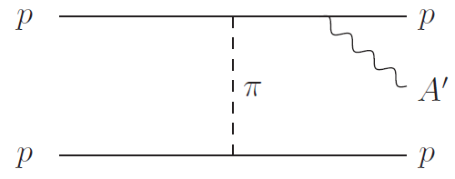
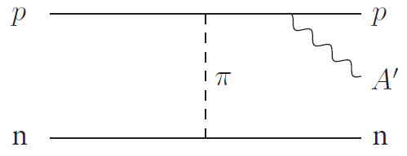
Production in the core of SN
9605350
1201.2683
The dominate process
Other processes are relatively suppressed, e.g. the Compton-like scattering, by the number density in the core,

Slide 13
Production in the core of SN
The energy emission rate per unit volume with S symmetry factor, f_{1,2} NR Maxwell-Boltzmann distribution of the two incoming nucleons, with the energy factor (E_{A’}) removed from the formula, we get the number emission rate without any decaying factor in the formula
The emission rate depends on:
Baryon number density
Temperature in the core
Kinetic mixing and DP mass
Fermi density
Up to few 10 MeV
The parameter of interest

Slide 14
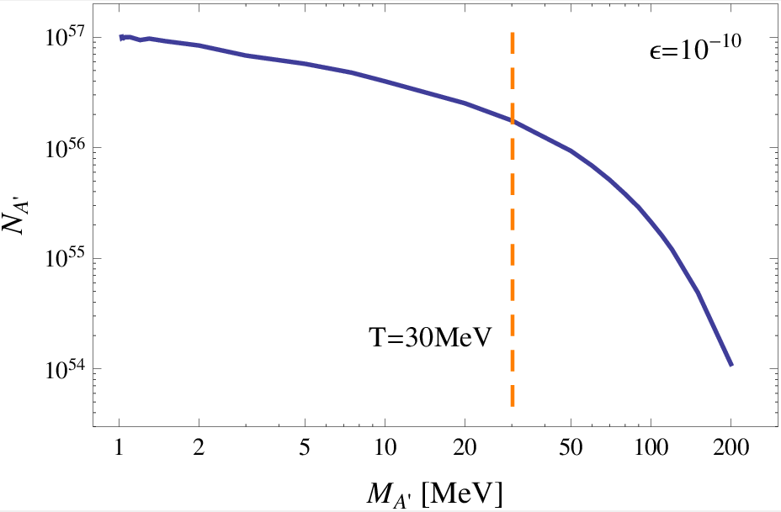
How many DPs can be produced in the SN core?
A huuuge number of DPs! (For 10 MeV DP)
Based on extremely naively simple assumptions of the SN core; More detailed modeling is much more complicated.
What’s in the innermost of the core? It might go beyond our imagination!

Slide 15
Decaying (into e⁺e⁻) & SN constraints
0009290
e+e- from DP and photons could induce intense gamma-ray burst
constrained by observation of gamma-ray from SN1987A
mantle
Numerous & energetic e+e- could blow away all the stellar material beyond the decay radius… constrained by the gravitational binding energy
core
~10⁶ cm
Decaying outside the core constrained by the luminosity
~3x10¹² cm
Decaying in the core is NOT effective at cooling the star
unless A’ decays into DM… [1404.7172]

Slide 16
DP Decay
The e⁺e⁻ channel (in the CMB frame) DP can also decay into other heavier SM particles (e.g. muon & pion), as long as it is heavy enough…
The three-photon channel
The SN size scale
The cosmology age scale

Slide 17
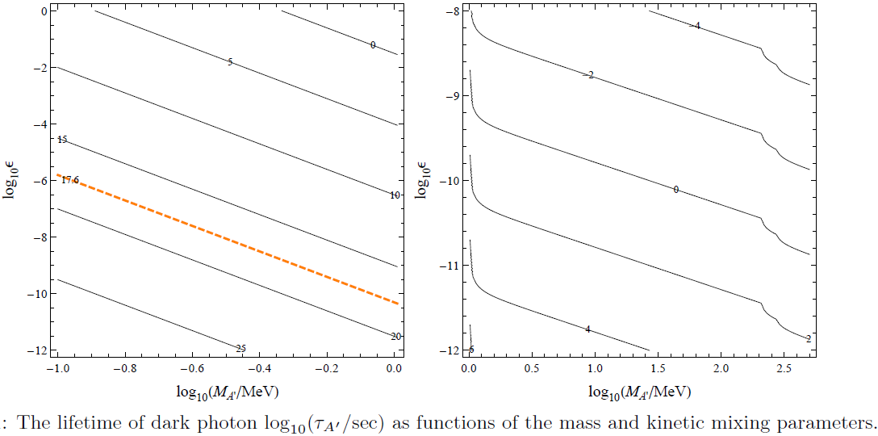
Numerical results
The age of our universe

Slide 18
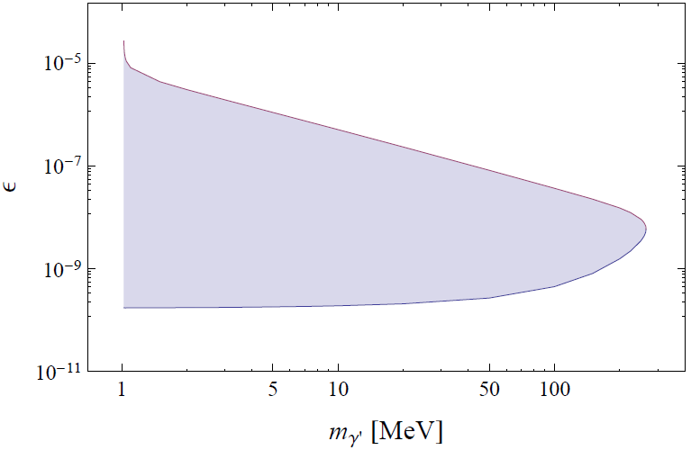
Decaying outside the core
Observation: the neutrino luminosity
The energy loss due to the DP should not exceed the neutrino luminosity.
Upper bound due to decaying in the core
EXCLUDED
DP too heavy to produce abundantly
Mass > 2me
Lower bound constrained by luminosity

Slide 19
Decaying inside the mantle
If the DPs decay inside the mantle, the numerous & energetic e⁺e⁻ can blow away all the stellar material beyond the “decay radius”, generating a fast moving hot ejecta starting an intense light emission.
NON-existence of such ejection sets sets new strong limits on the mass and mixing parameters.

Slide 20
Blow-away condition
At some radius R⁰ the energy deposited threin by the e+e− from outstreaming DPs exceeds the gravitational binding of the mantle
Energy
Energy deposited
Binding energy

Slide 21
Blow-away condition
Deposited energy Plugging the decaying factor in the energy emission rate Q_{A’} , The extra ε² factor accounting for decaying in the mantle
The binding energy M* progenitor mass, density profile of the progenitor is model dependent…
The value we used for the calculation We found that a factor of 10 for M*δM does not bring too much change to the constraint

Slide 22
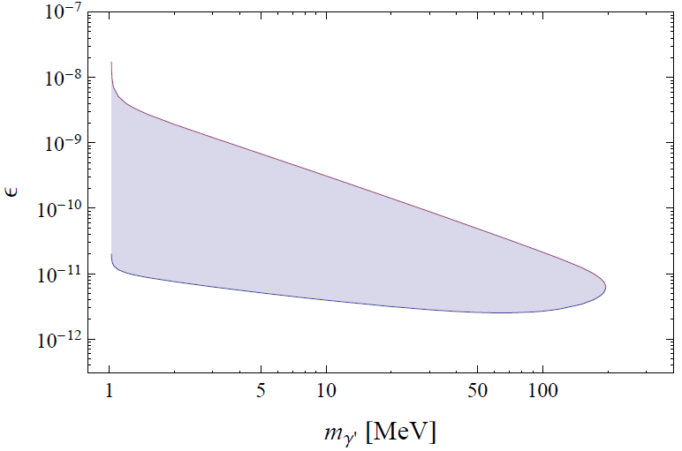
Constraint due to binding energy
EXCLUDED

Slide 23
Decaying at the surface
With ε₁₀=1, the decay length is at the scale of the mantle size, i.e. sizable portion of DPs decay at the mantle surface.
We have the e⁺e⁻ plasma (from DP-decay) and photons (from heat of the surface & e⁺e⁻ annihilation) at the surface.

Slide 24
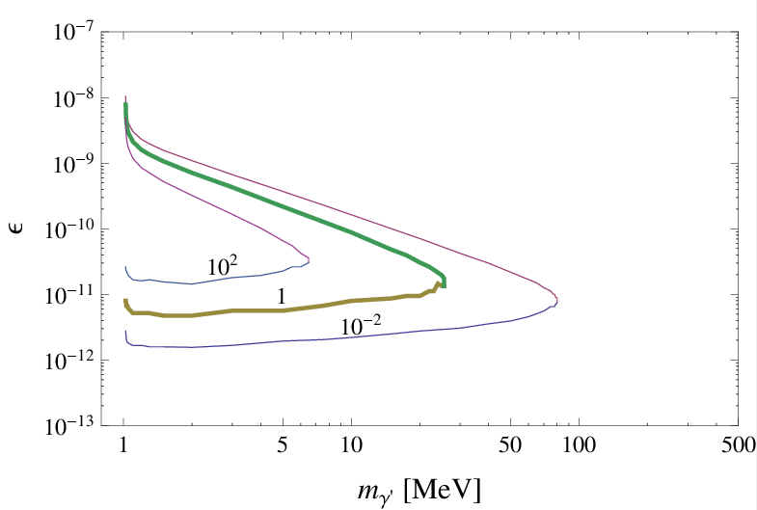
Optical depth
We need to know the optical depth of e⁺e⁻ at the surface, which represents how probable it is that the e⁺e⁻ will undergo annihilation into photon pairs
Column number density
One factor of ε² dependence from the number of DPs produced
Another factor of ε² dependence from decaying of DPs at the surface
Thompson scattering
cross section

Slide 25
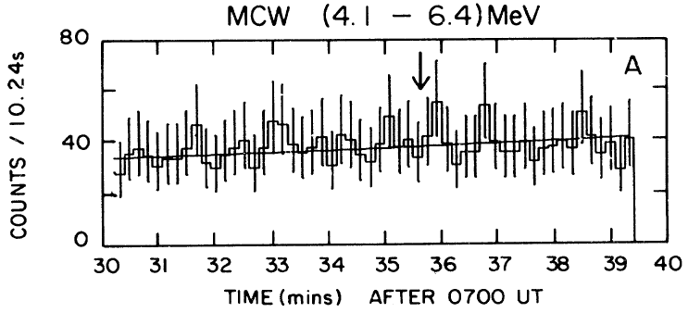
gamma-rays from the surface
If the optical depth κ>1, the plasma will generate a prompt gamma ray burst with MeV energy, with a fluence (for smaller values of κ, the gamma rays produced are suppressed), the numerator representing the # of DPs emitted from the surface
NON-observation of the gamma-rays from SN1987A puts severe constraint on the DP parameters
PRL62,505
PRL62,509
Solar Maximum Mission (SMM) gamma ray observation

Slide 26
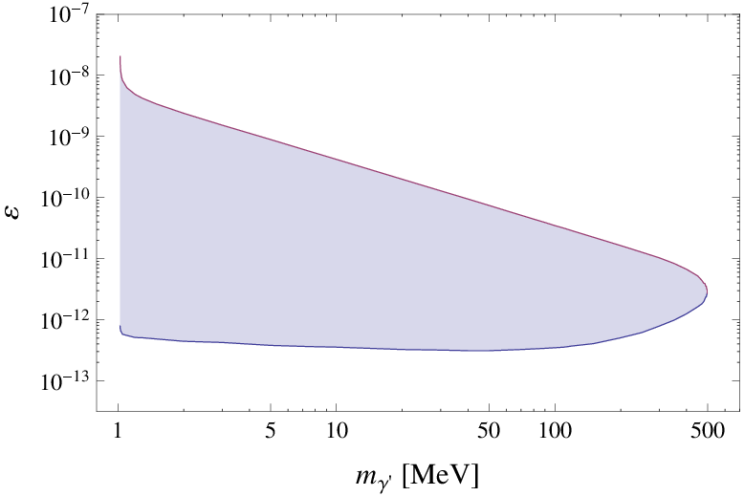
Constraint due to gamma-rays
EXCLUDED
Notes:
SMM: Solar Maximum Mension satellite

Slide 27
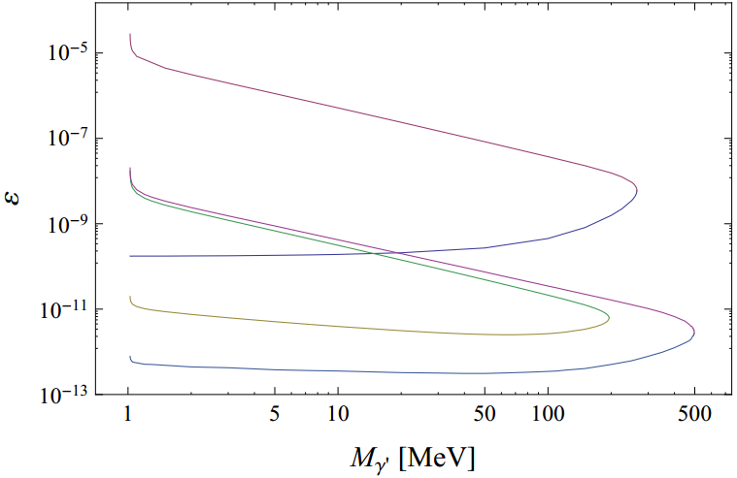
the constraints for M_{A’} > 2m_{e}
luminosity constraint
EXCLUDED
gamma-ray constraint
binding energy constraint

Slide 28
If M_{A’} < 2m_{e} … (luminosity constraint)
When the DP mass < 2m_{e} , the loop-induced three-photon decay is the single channel kinetically allowed.
In this case, the decay length of DP could “easily” exceed the age of our universe,
However, the luminosity constraint applies, excluding the kinetic mixing larger than

Slide 29
… at the cosmological scale (gamma-ray constraint)
We consider the cumulative effect of all DPs emitted from all supernovae since z=1 in the universe.
Taking 10¹² galaxies in the universe, and the SN rate as one per century in one galaxy, we get the total number of SN to be 1.3x10²⁰.
The kinetic mixing is then constrained by the SMM observation of the MeV gamma-rays.
The photons from DP-decay will be visible only if their decay length is less than size of the universe Consequently, for a lighter DP, the mixing needs to be larger.

Slide 30
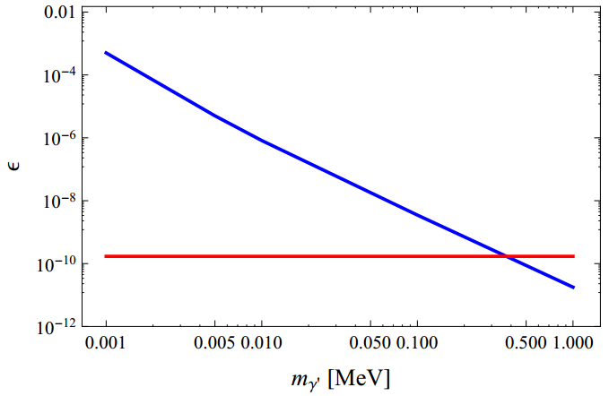
the constraints for M_{A’} < 2m_{e}
EXCLUDED
EXCLUDED
EXCLUDED

Slide 31
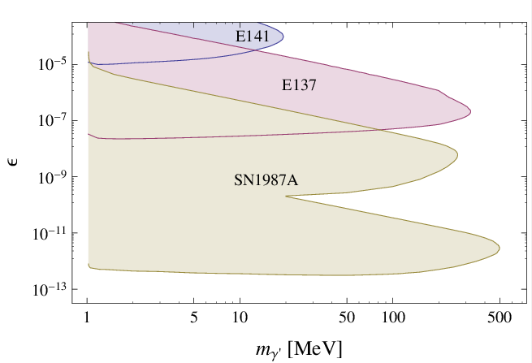
Summary
EXCLUDED
luminosity constraint
gamma-ray constraint
binding energy constraint

Slide 32
Summary
EXCLUDED

Slide 33
Open questions
What if there exists DM in the SN core? cf. the paper by Yue Zhang [1404.7172]; however there are some (private) debates on the arguments in this paper… Some relevant discussions on DM capture in the core of Sun or Earth…
More constraints from astrophysics and cosmology?
“there is also the possibilities of bounds from energy loss from red or blue giants, main sequence stars, and other astro objects perhaps, such as giant molecular clouds, galaxies, and galactic clusters.”
“it might also be possible to make figures with the cosmologically derived regions filled with lines slanted one way and the stellar derived regions slanted the other way. disagreements between the two would cry out for explanation and agreements would increase confidence. “
“the galactic clusters are perhaps the most likely to be informative since they are big and have x-ray temperatures. I don't know how long they are measured to last or what their fates are supposed to be (probably they evaporate most of the galaxies given enough time. this is maybe unexplored territory. I haven't seen a limit on proton (or electron) coupling to DM, based on the lifetime of galactic clusters.”
The phenomenology regarding the DP coupled to the W boson:

Slide 34
Thank you very much!

Slide 35
Backup slides

Slide 36
Contents
Motivation more words on why we need a DP, the current constraints
Production in the supernova core
Decay and the supernova constraints (>2me) decaying outside the core: luminosity decaying inside the mantle: blow-away decaying at the surface: gamma-rays
Constraint for a lighter dark photon (<2me) decay so slow…
Summary and open questions

Slide 37
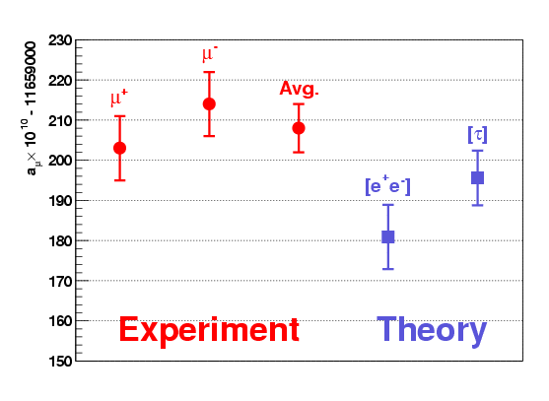
Muon g-2

Slide 38
Some proposed experiments
1311.0029

Slide 39
Constraints for mass <2m_{e}
1002.0329; 1205.2671;
1303.1821; 1311.0029
Dark green: experimentally excluded regions
Blue: astrophysical or cosmological arguments
Gray: constraints from astronomical observations
light green: planned and suggested experiments ADMX, ALPS-II, Dish antenna, AGN/SNR
Red: accounting for all the DM
Regions bounded by dotted lines: predictions from string theory

Slide 40
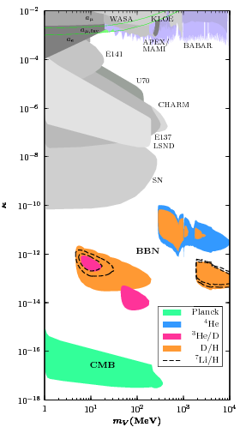
cosmological constraints
1407.0993
The late decays of DPs with mass MeV - 10 GeV would effect the CMB and BBN
Constraints downward to an effective coupling of order 10⁻³⁸
complementary to the constraints from SN (relevant) observations
Notes:
10^{-38}

Slide 41
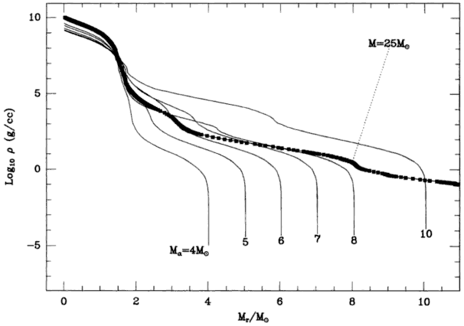
Density curves of the progenitor
Arnett, supernovae and nucleosynthesis

